Slide 1
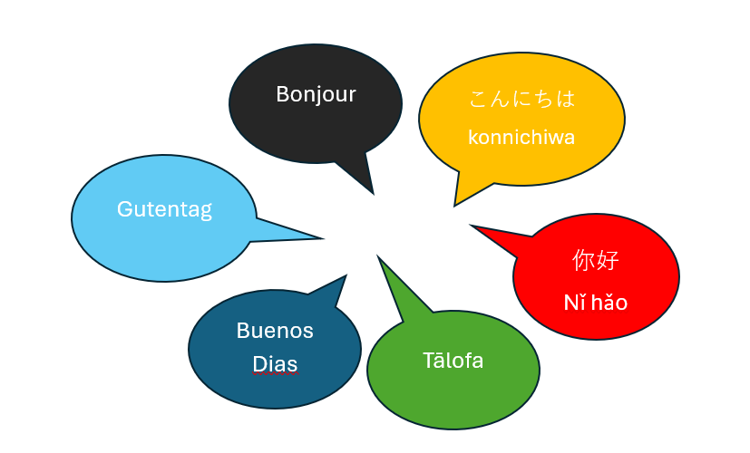
NZALT Wellington
LangSem 2025
Date: Saturday 19 July, 8:50 a.m. - 3:15 p.m.
Venue: Wellington High School
Keynote: Adriana Ramirez
A relaxed and practical day for language teachers to come together and:
Take part in language-specific chat and share sessions
Join workshops led by the Tui Tuia National Language Advisors and experienced teachers
Hear from Shirley Bain (NZQA) with updates on task writing and moderation
Connect with colleagues from across the languages teaching community
☕ Start the day with coffee and pastries on arrival 🍽 Morning tea and lunch provided

